Slide 1

"Put me in, Coach"
Fostering Inclusivity and Constructive Dialogue
in Athletic Programs
A presentation for the ​Council for Athletic Affairs​
of the Florida College System Activities Association
By Bruce W. Fraser and Alexander Kanter​
Indian River State College
Copyright © 2022 New Common Ground, LLC.
All Rights Reserved

Slide 2
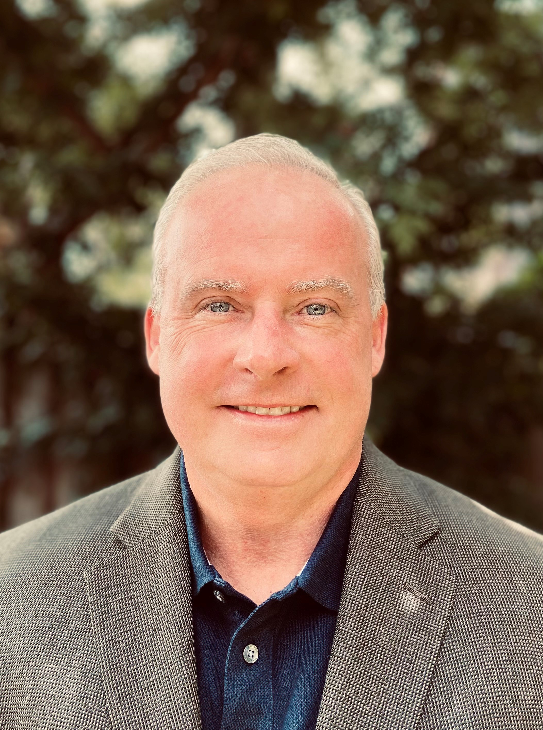
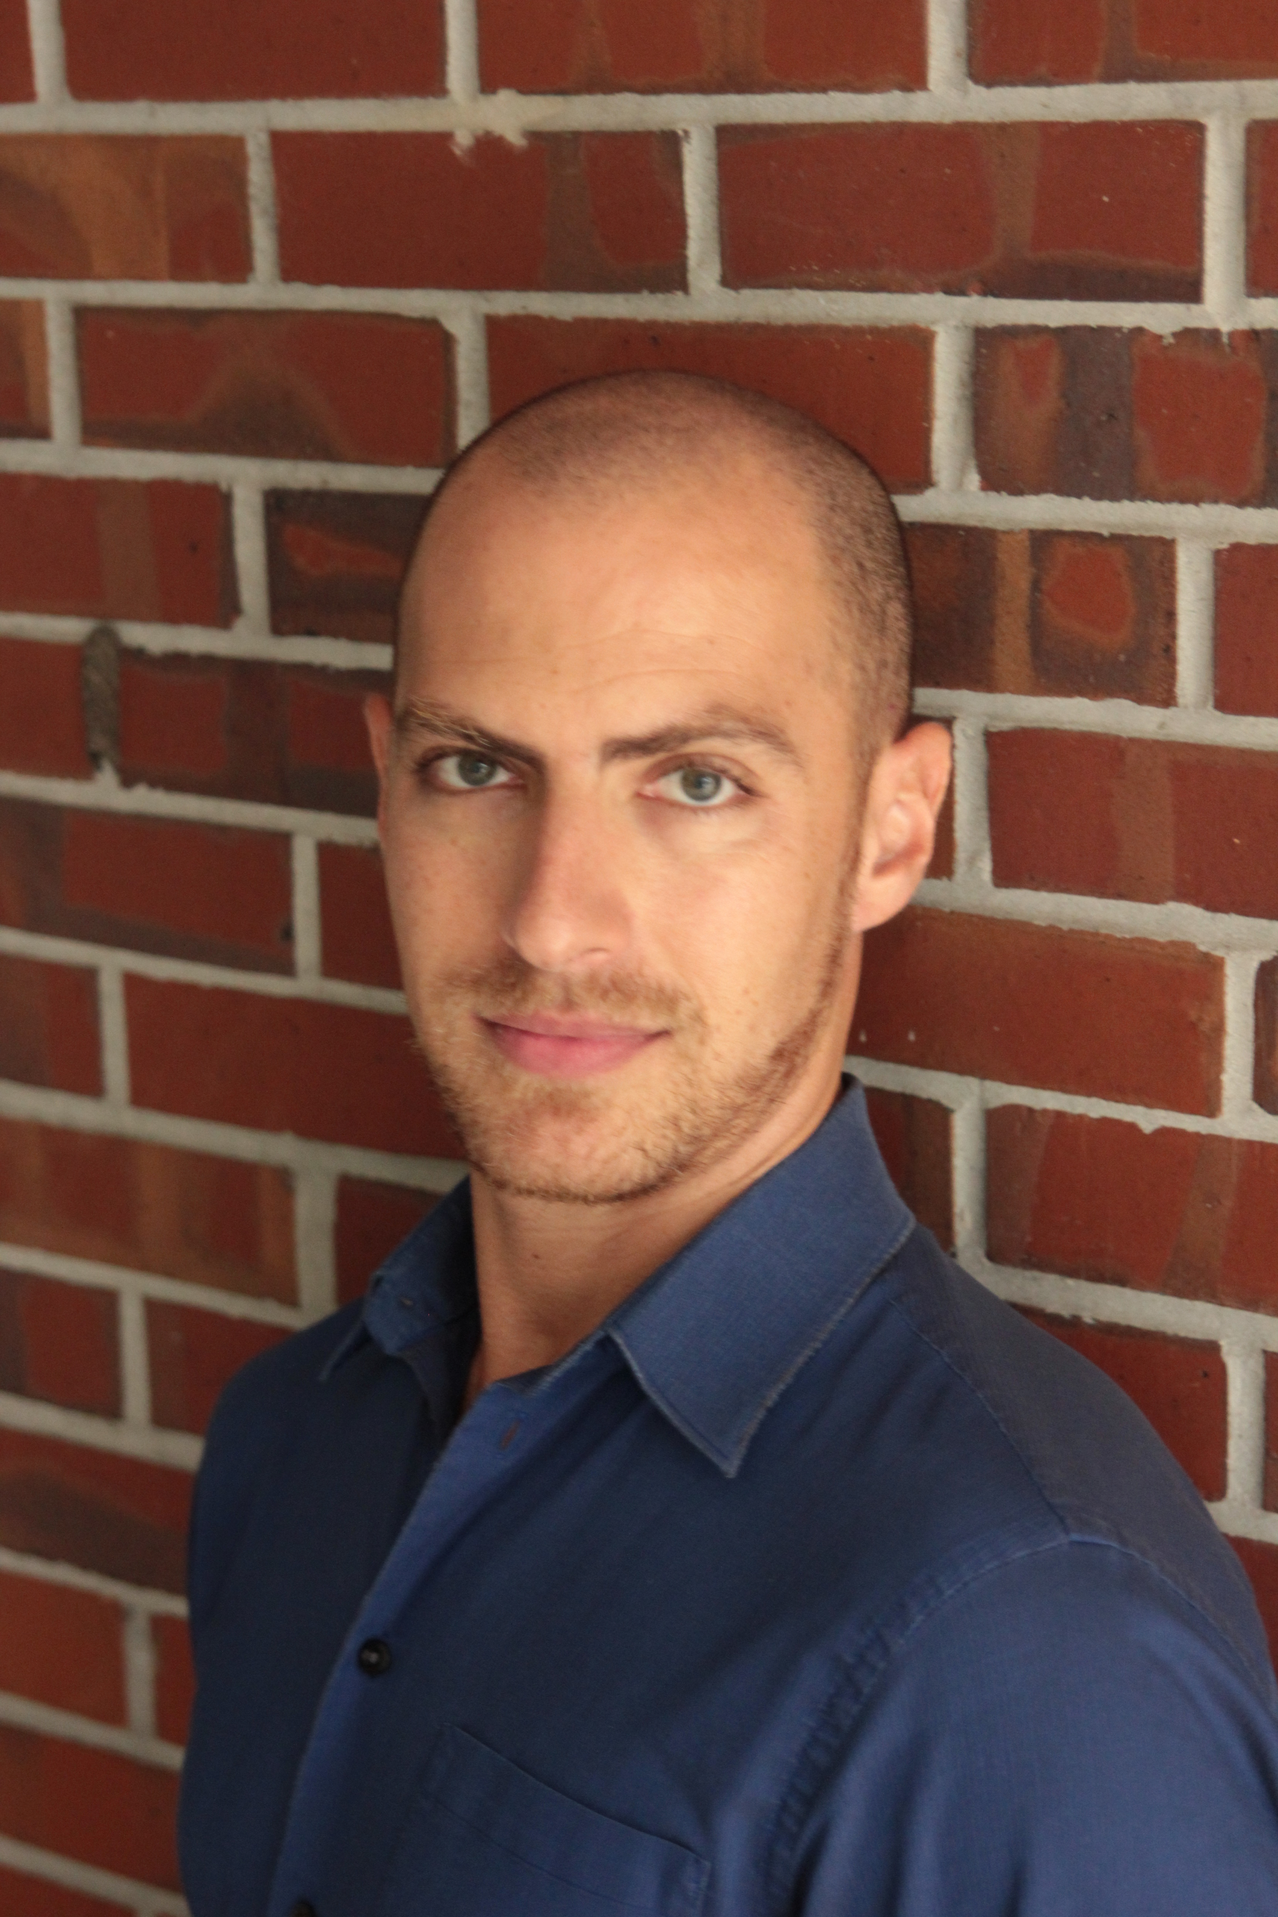
Presenters
Bruce W. Fraser, Ph.D.
Director of the Institute for Academic Excellence
Professor of Philosophy
Indian River State College
CEO, New Common Ground, LLC
Alexander Nathan Kanter, MFA
Master Instructor of Theatre
Director of Theatre and Dance
Indian River State College
VP, New Common Ground, LLC

Slide 3

Why Inclusion?
Minimizing unhealthy conflict maximizes our potential
Diversity of ideas and experience is essential for improving performance
This Photo by Unknown author is licensed under CC BY-NC-ND.

Slide 4
Inclusion Blocks
Assumptions and mental shortcuts
Naïve Realism
Silo-ing
Fragility

Slide 5
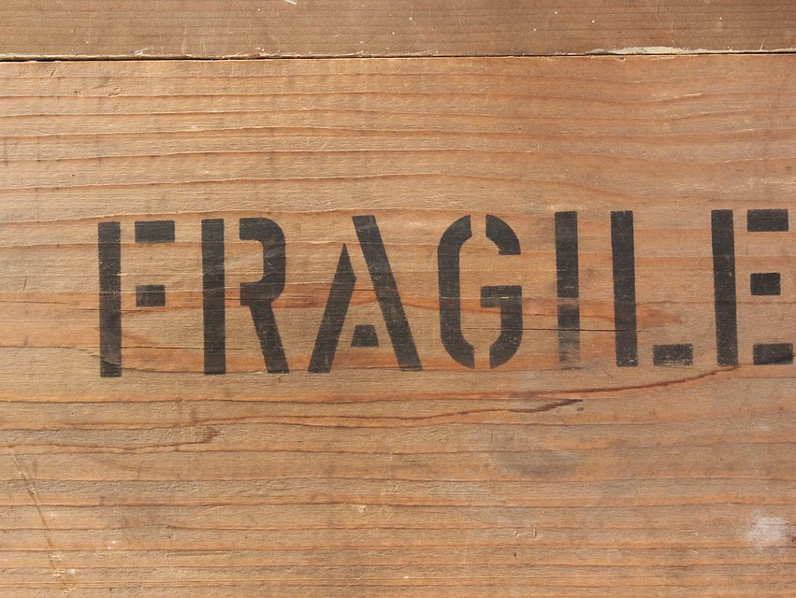
Fragility
"Survival Mode" mentality
Defensive moves and thoughts
Filtered world-view
Inhibits full participation

Slide 6
NCG's approach to overcoming fragility
Integrity
Connectivity
Empowerment
ICE it!

Slide 7
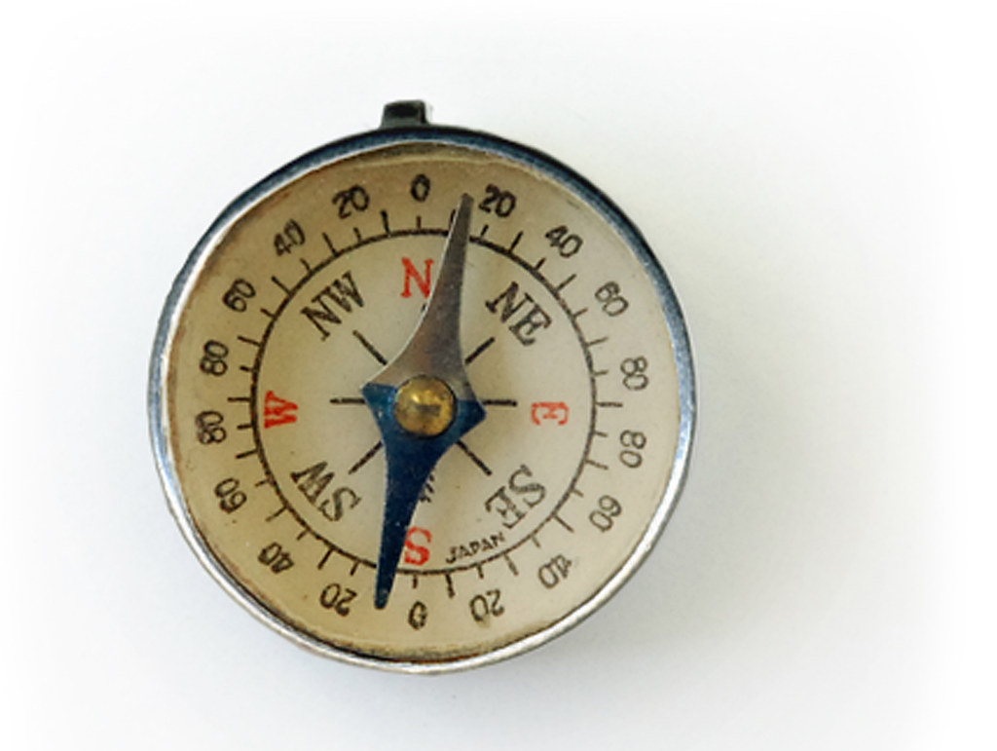
Integrity
Reconnecting with core values and beliefs
Investigating the "why" the "how"
Acknowledging our "Frames of Reference"
Lived Experiences
Socially derived scripts
Media
Education
This Photo by Unknown author is licensed under CC BY.

Slide 8
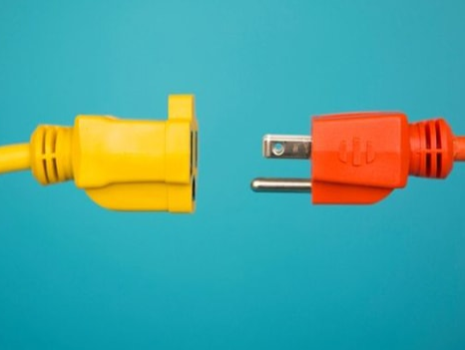
The Disconnect
Illusion of Communication
Tapping exercise
Predictive vs. Vested Listening
This Photo by Unknown author is licensed under CC BY-SA-NC.

Slide 9
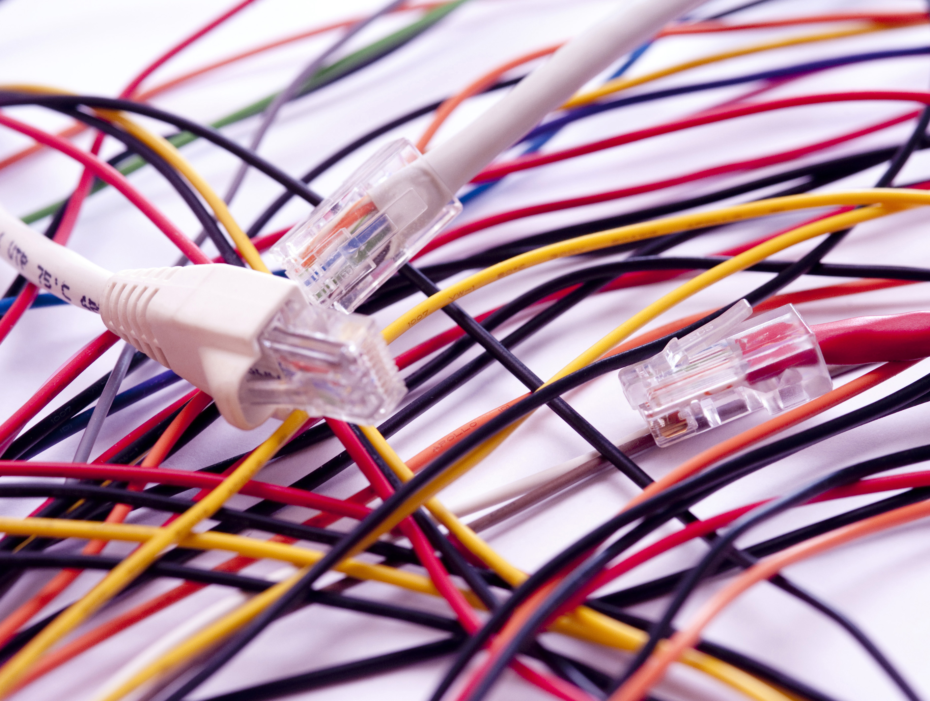
Connectivity
Vested Listening with the 3 I's
Is / Ought
Identifying emotionally-charged language
"I hear you"
Sensing others' Pressure Points
Regulating our own Pressure Points
Note: Connectivity DOES NOT require compromise or agreement
Connectivity DOES encourage understanding and curiosity
This Photo by Unknown author is licensed under CC BY.

Slide 10
Creating an Inclusive Environment
Make room for each other's opinions
Aim for "I" statements
Protect the neutral zone
Respect pressure points
Value lived experiences
Speak in specifics

Slide 11
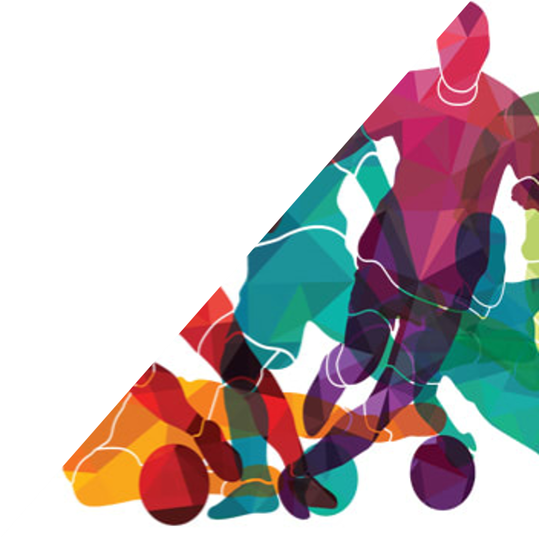
Empowerment
Using authentic communication to make positive changes in our environments
Being our "whole selves" around others
Conveying vs. Convincing
Shifting away from a "win-lose" mentality

Slide 12
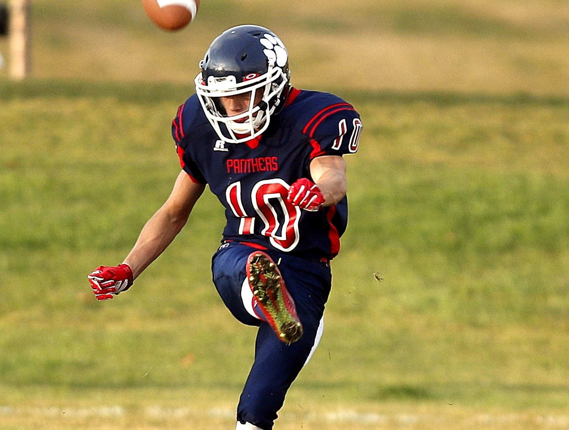
Inclusivity Benefits
"The Kicker"
Diversity Bonus
  Increased productivity, engagement, and commitment.
As we practice Integrity, Connectivity, and Empowerment...
...no one feels "benched."

Slide 13

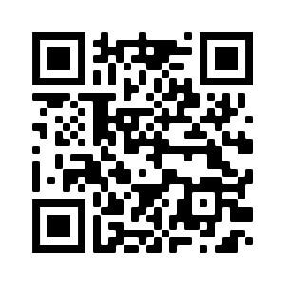
NCG contact information
Bruce W. Fraser
bfraser@newcommonground.com
Copyright © 2022 New Common Ground. All Rights Reserved

